Slide 1
A Hierarchical Bayesian Model for Hurricane Trajectories
Group 3: Wenhao Gou, Qestiyah Wang,
Jared Klug

Slide 2
Hierarchical Linear Model
Also called Mixed Effects Model
Measure both Within-Group Analysis and Between-Group Analysis
Within-Group Analysis (Random Effects)
Observations are collected with natural heterogeneity in units of subjects across the populations over research time periods.
Not independent and violate the underlying assumption for linear regression.
Nest data and account as Individual-level Specific effects.
Between-Group Analysis (Fixed Effects)
Primary study Interest of analysis
Population-level mean response, shared by all subjects and considered as linearly and independently.

Slide 3
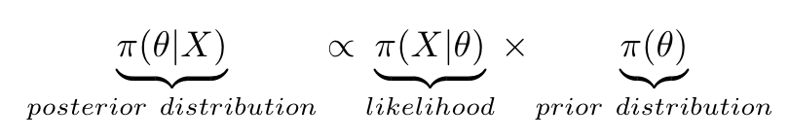
Bayesian Inference
The statistical inference method for estimating the parameter
Parameters are regarded random variables and follow a probability density or mass function
Before data collection, a prior distribution for the parameter would be pre-assumed based the current belief on it
With observed data, the prior information of parameter can be updated with estimation by posterior distribution, following Bayes’ Rule.
Incorporate with Markov Chain Monte Carlo for decreasing estimation uncertainty with large sample size of parameters.
Impacted by selection of proper prior
Possible to introduce subjectivity, especially for high dimensional data.

Slide 4
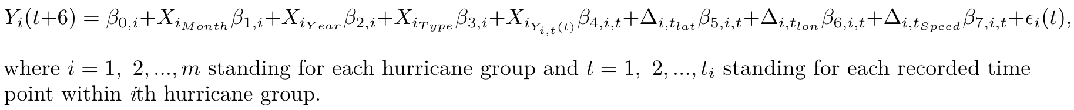
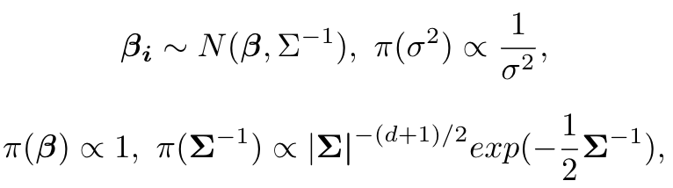
Explore the population-level changing trend of hurricane wind speed over years for a total of 356 hurricane groups.
Population-level: The intercept, Month, Year and Type.
Individual-level: the wind speed for t-1 time point, the change of latitude, longitude and wind speed.

Slide 5
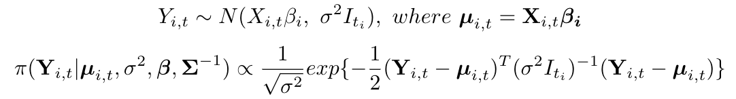
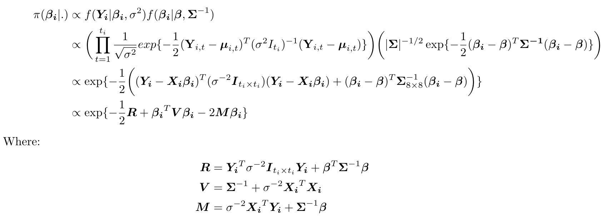
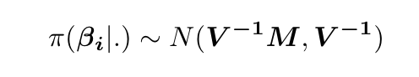
Posterior Distribution Inference

Slide 6
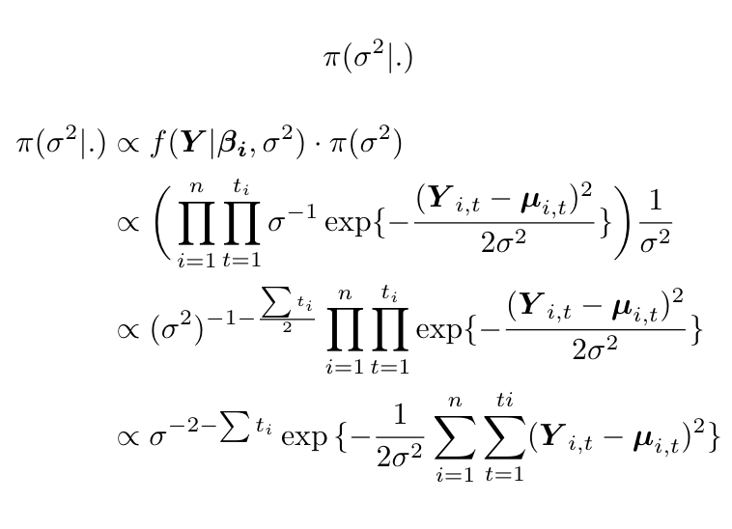
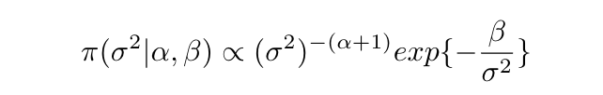
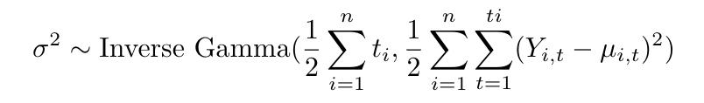
Posterior Distribution Inference
General Inverse Gamma:

Slide 7
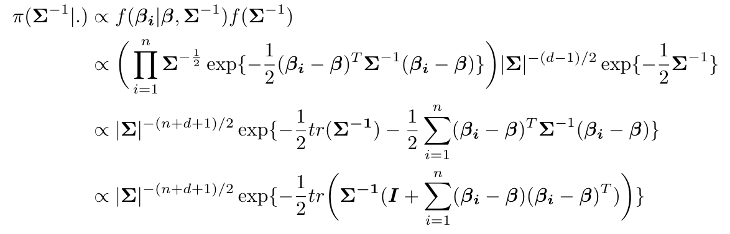
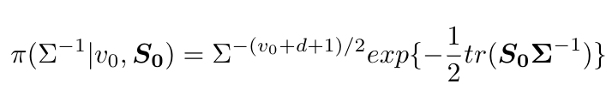
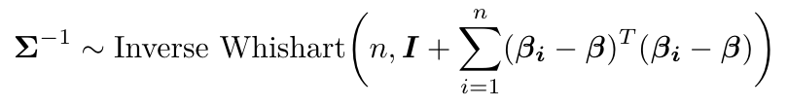
Posterior Distribution Inference
General Inverse Wishart:

Slide 8
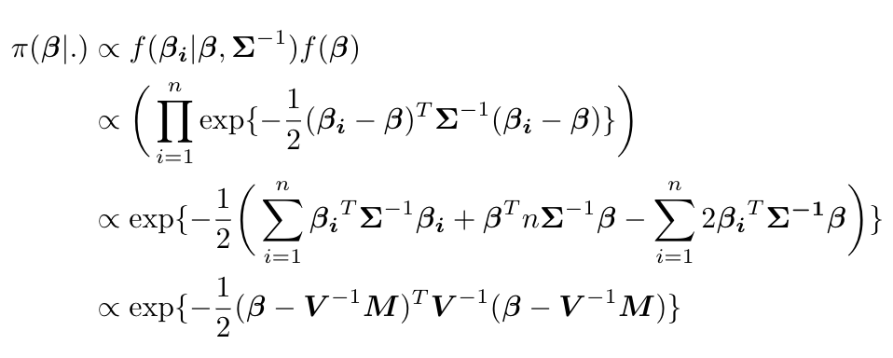
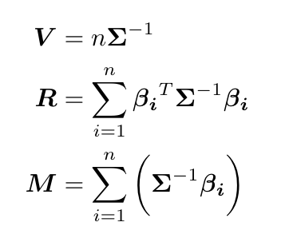
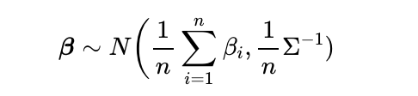
Posterior Distribution Inference
The Maximum Likelihood Estimator sampling distribution.

Slide 9
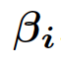
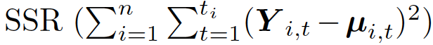
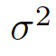
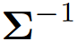
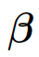
Markov Chain Monte Carlo
Gibbs Sampling Method
Order

Slide 10
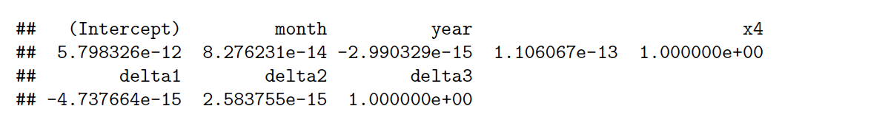
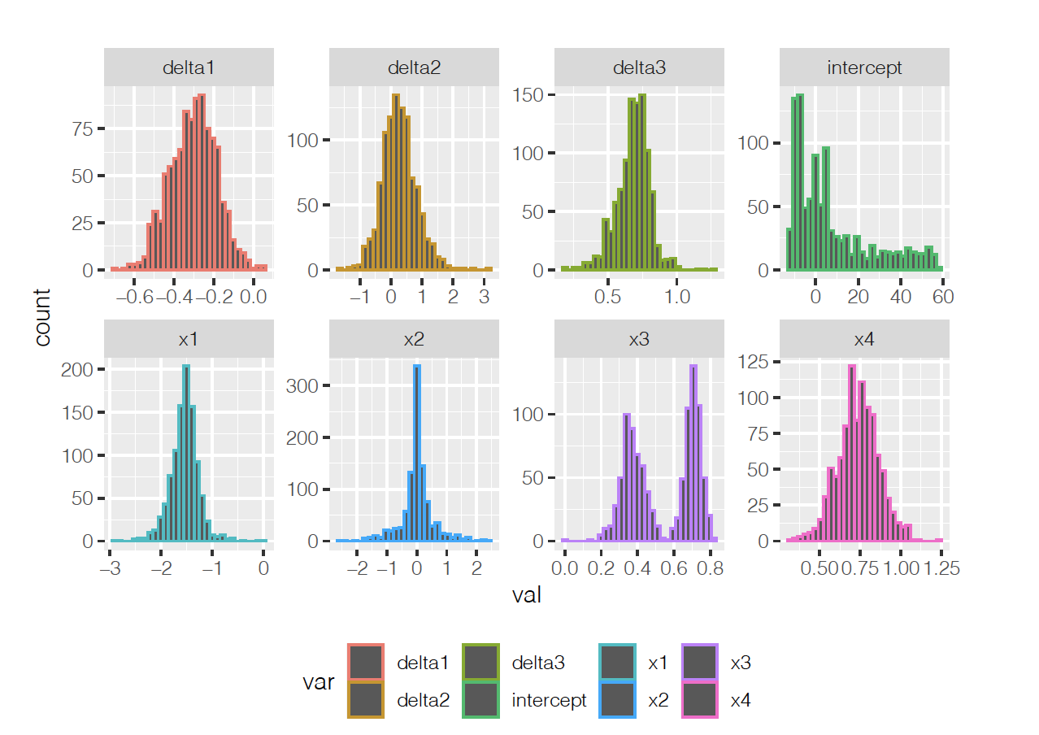
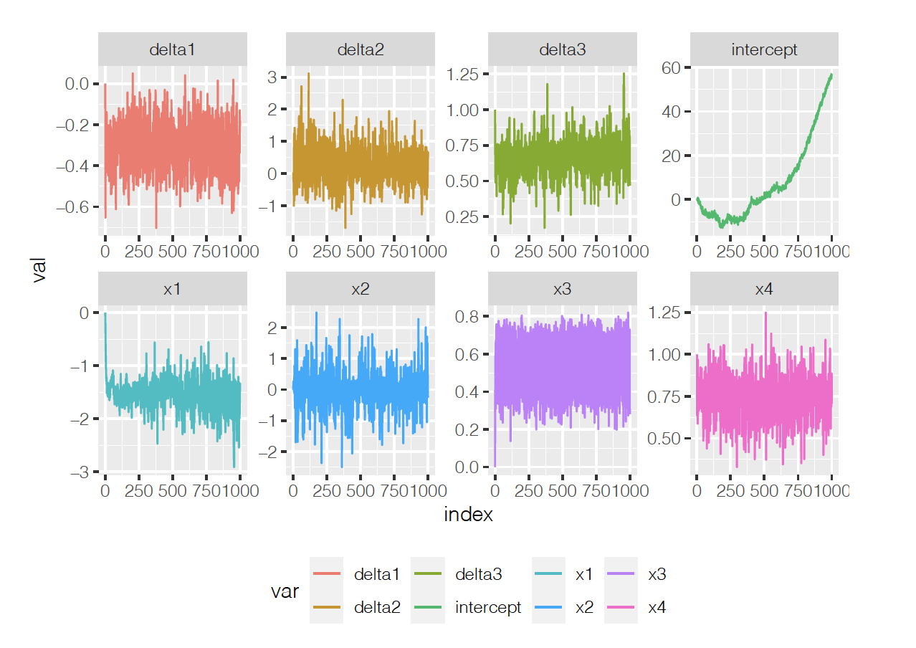
Discussion on MC Chain: Warm Start

Slide 11
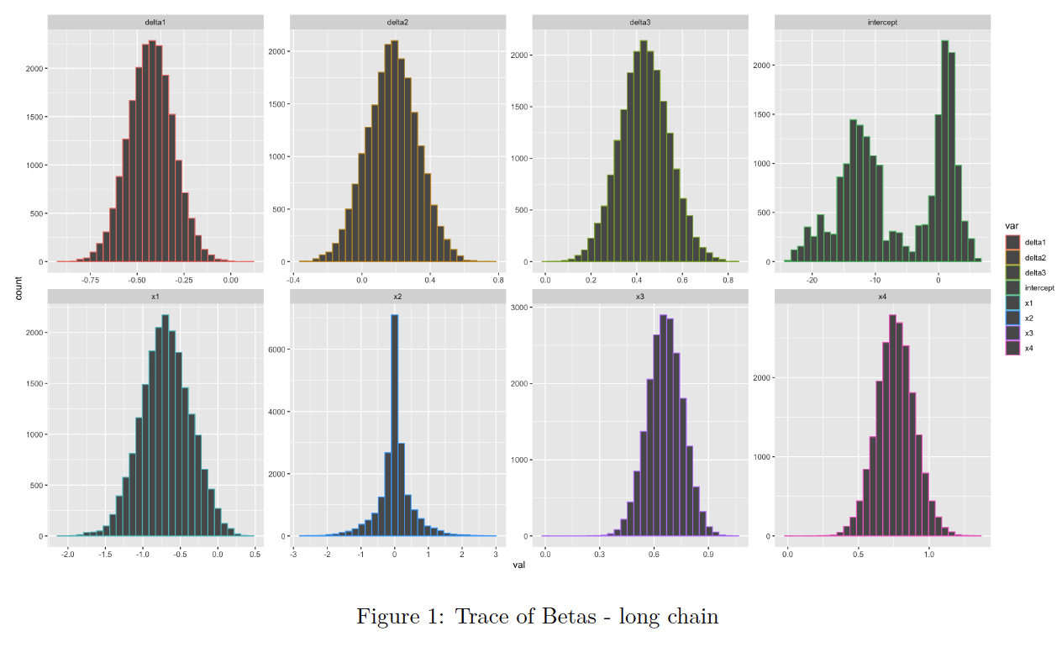
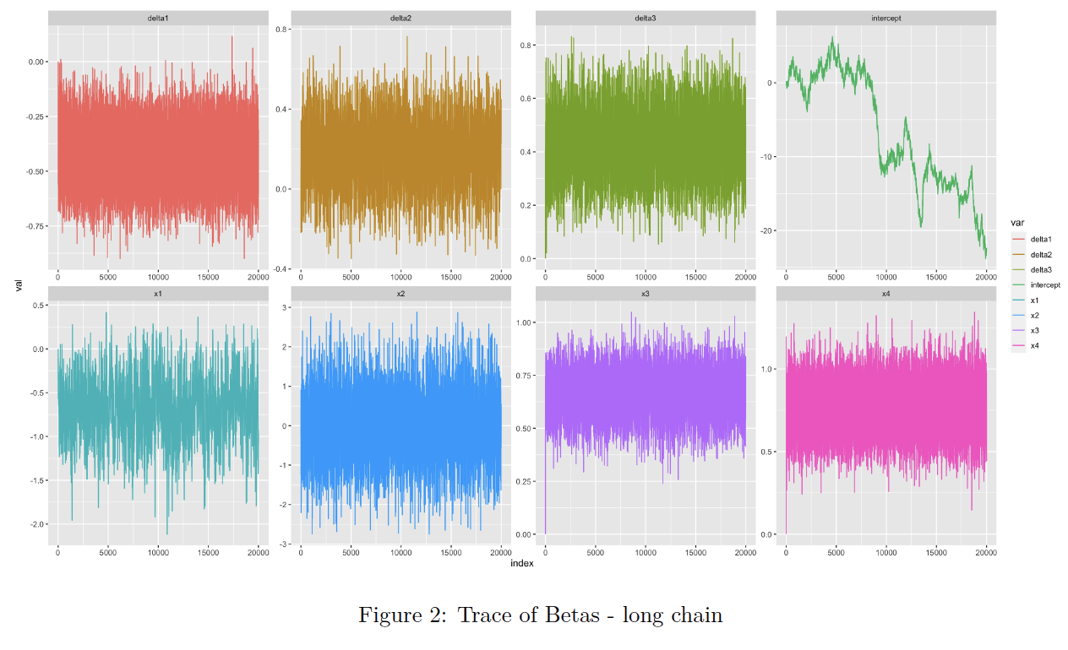
Discussion on MC Chain: Long chain

Slide 12
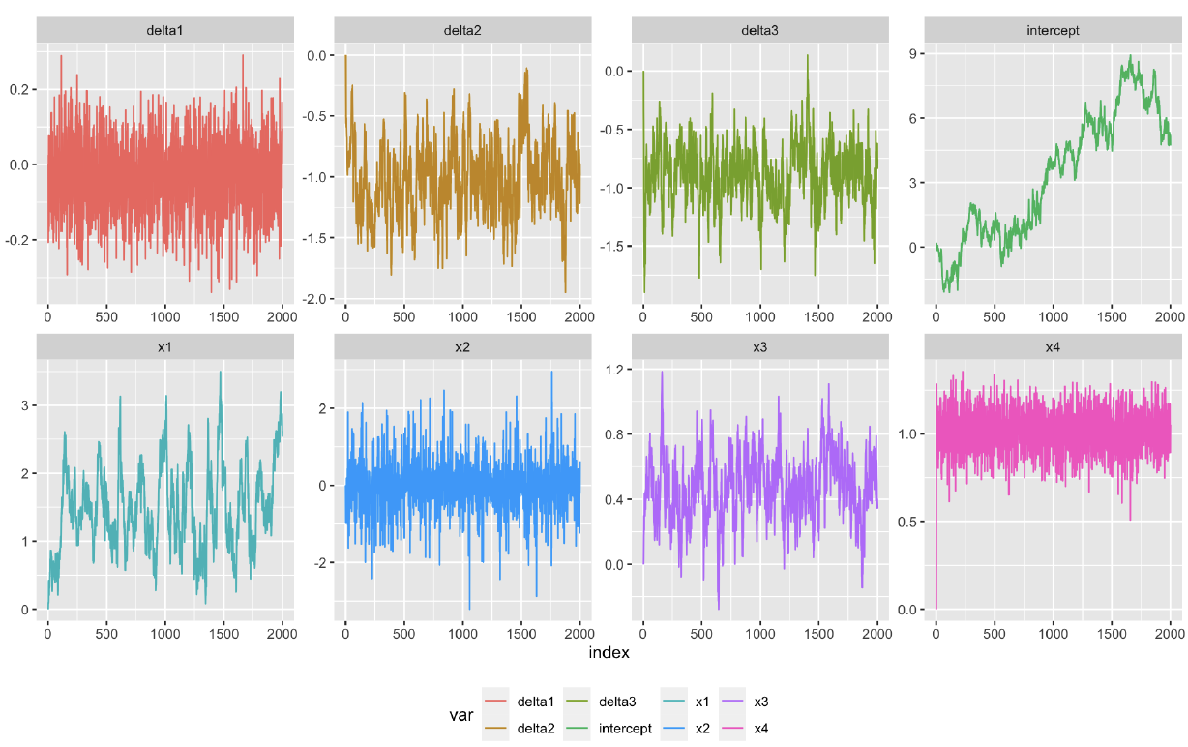
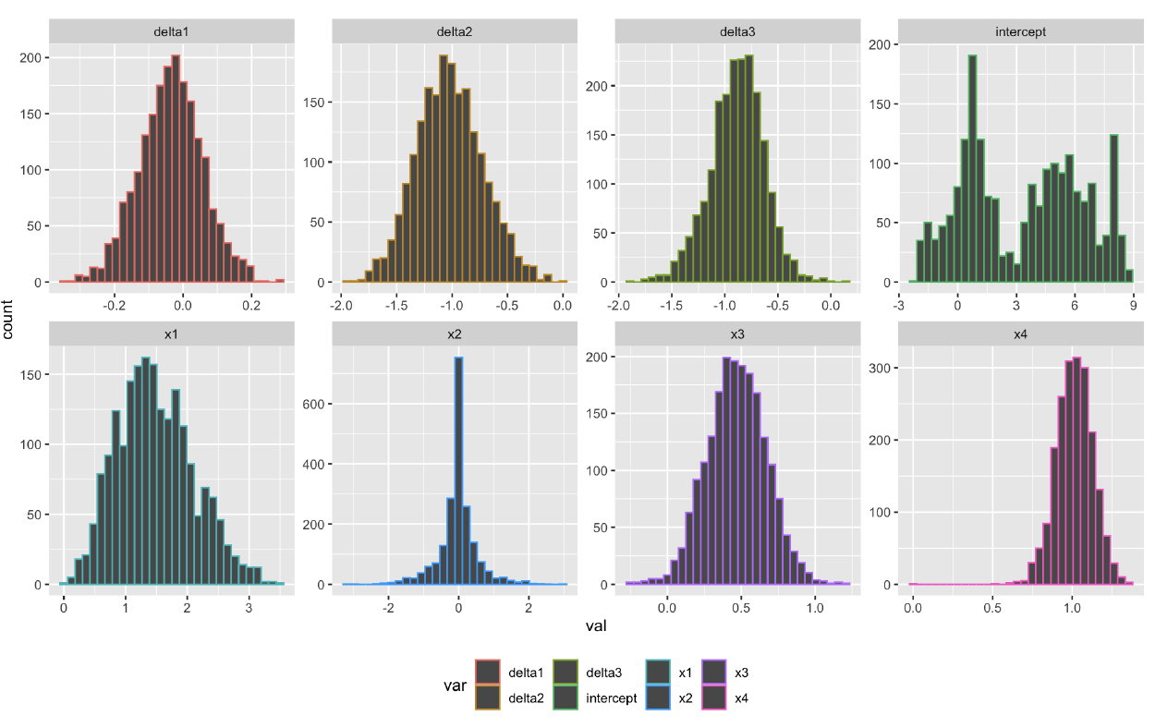
Discussion on MC Chain: Up Chain

Slide 13
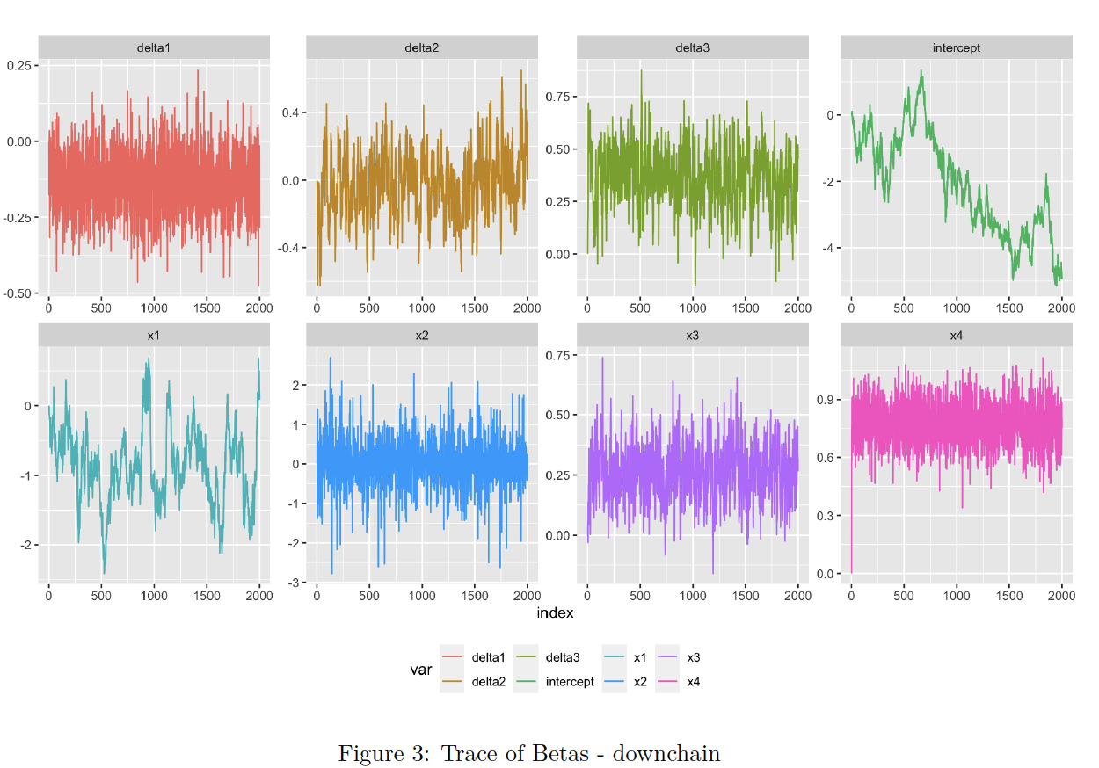
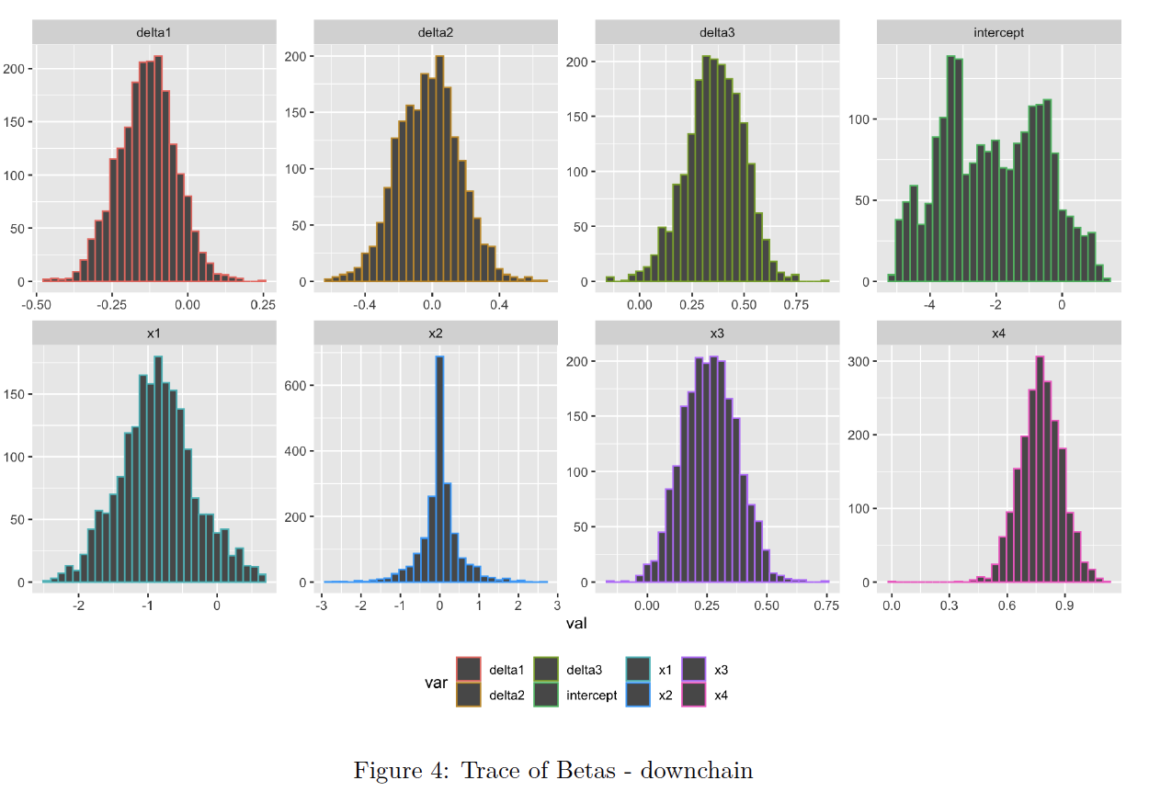
Discussion on MC Chain: Down Chain

Slide 14
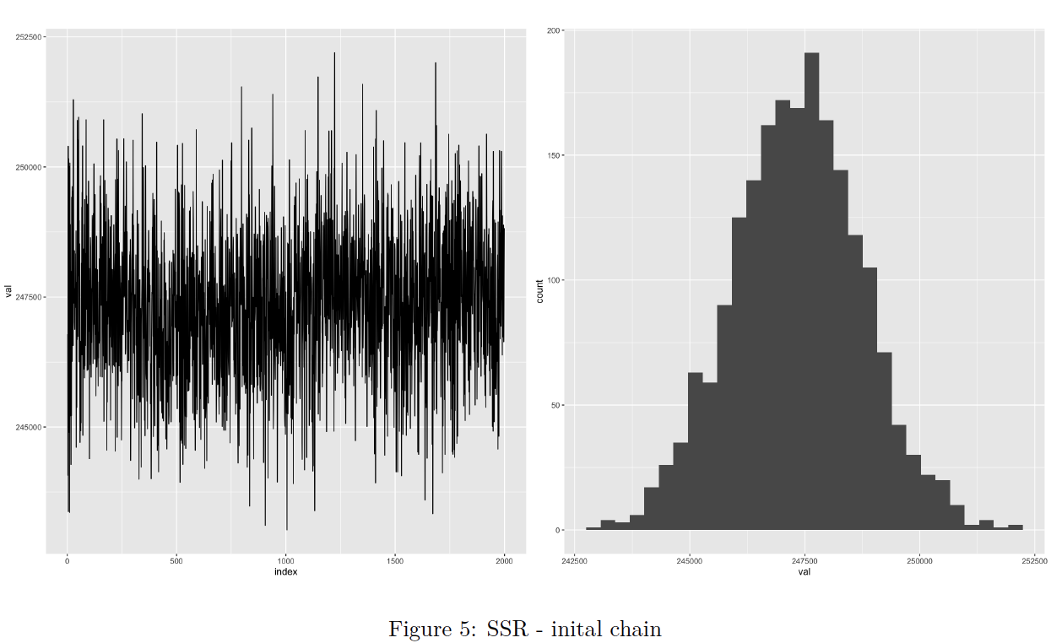
Investigate the models root mean square error:

Slide 15
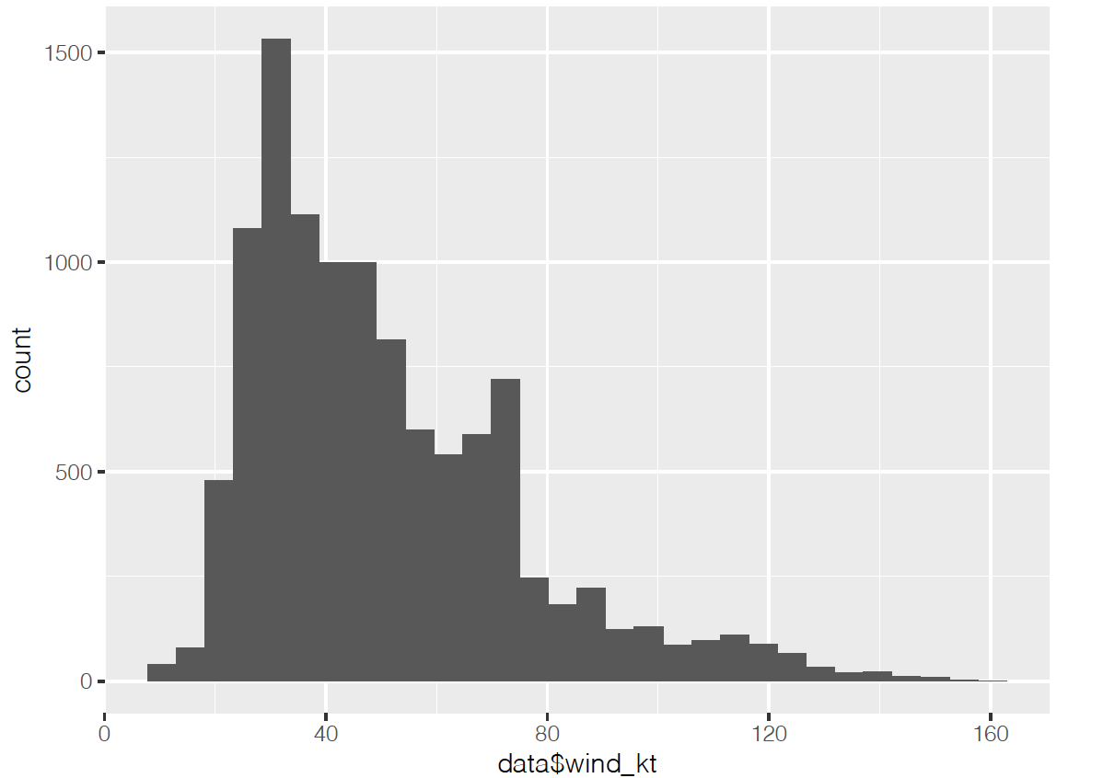
Weak Prior:

Slide 16
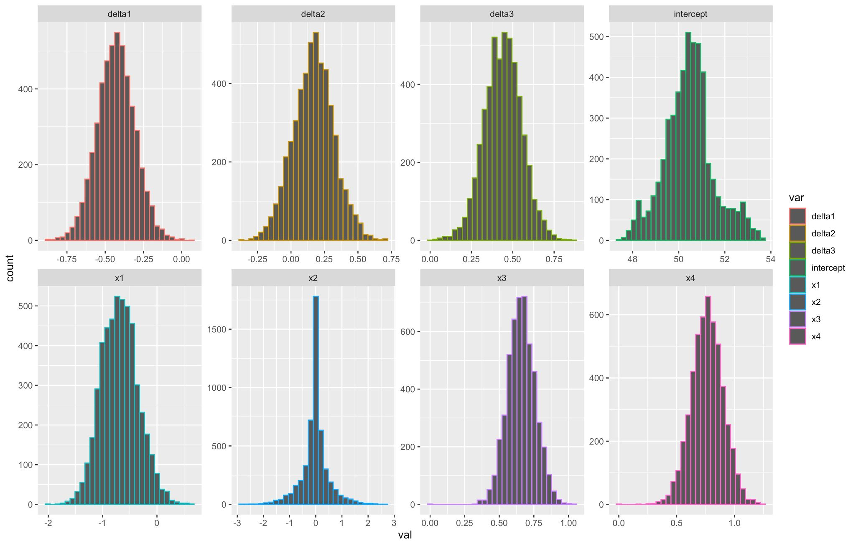
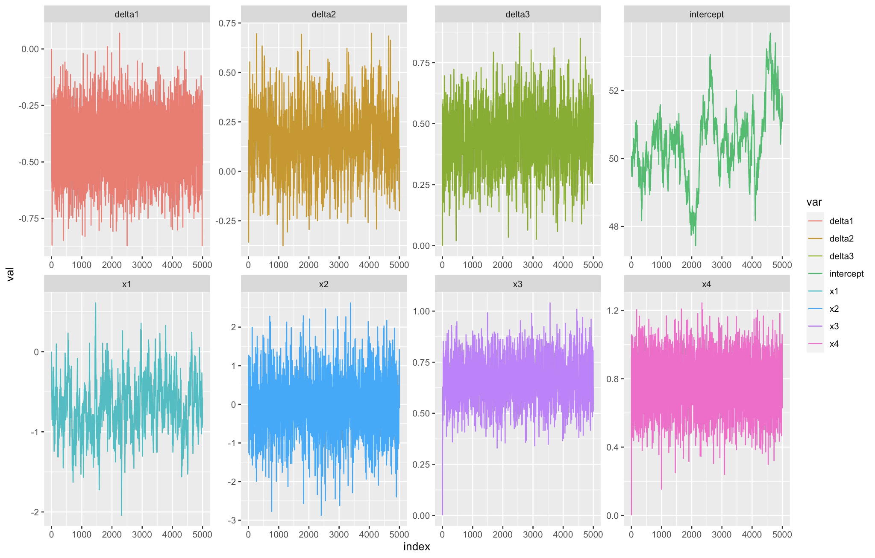
Gibbs Sampling Results (w/ Intercept)
All betas converged except for the intercept

Slide 17
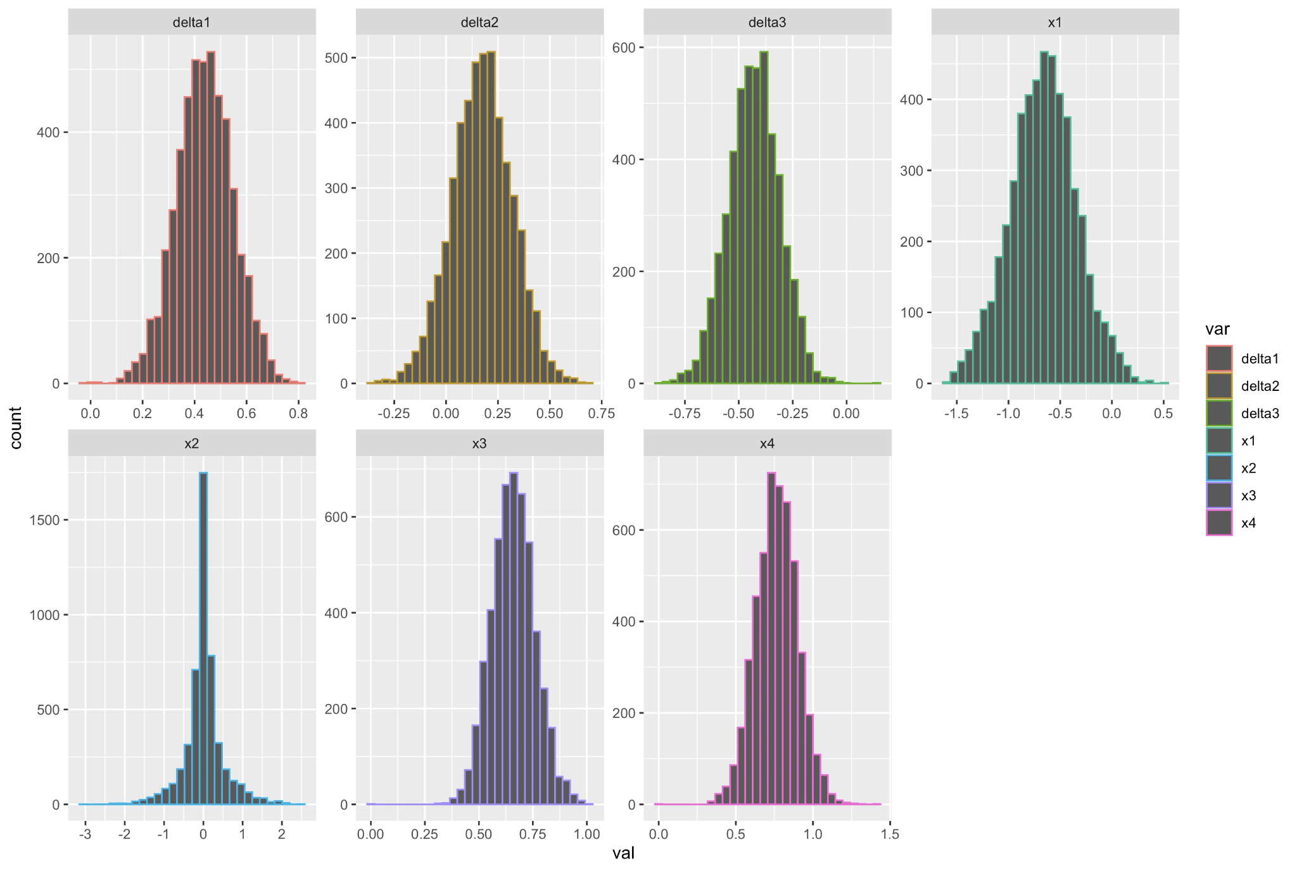
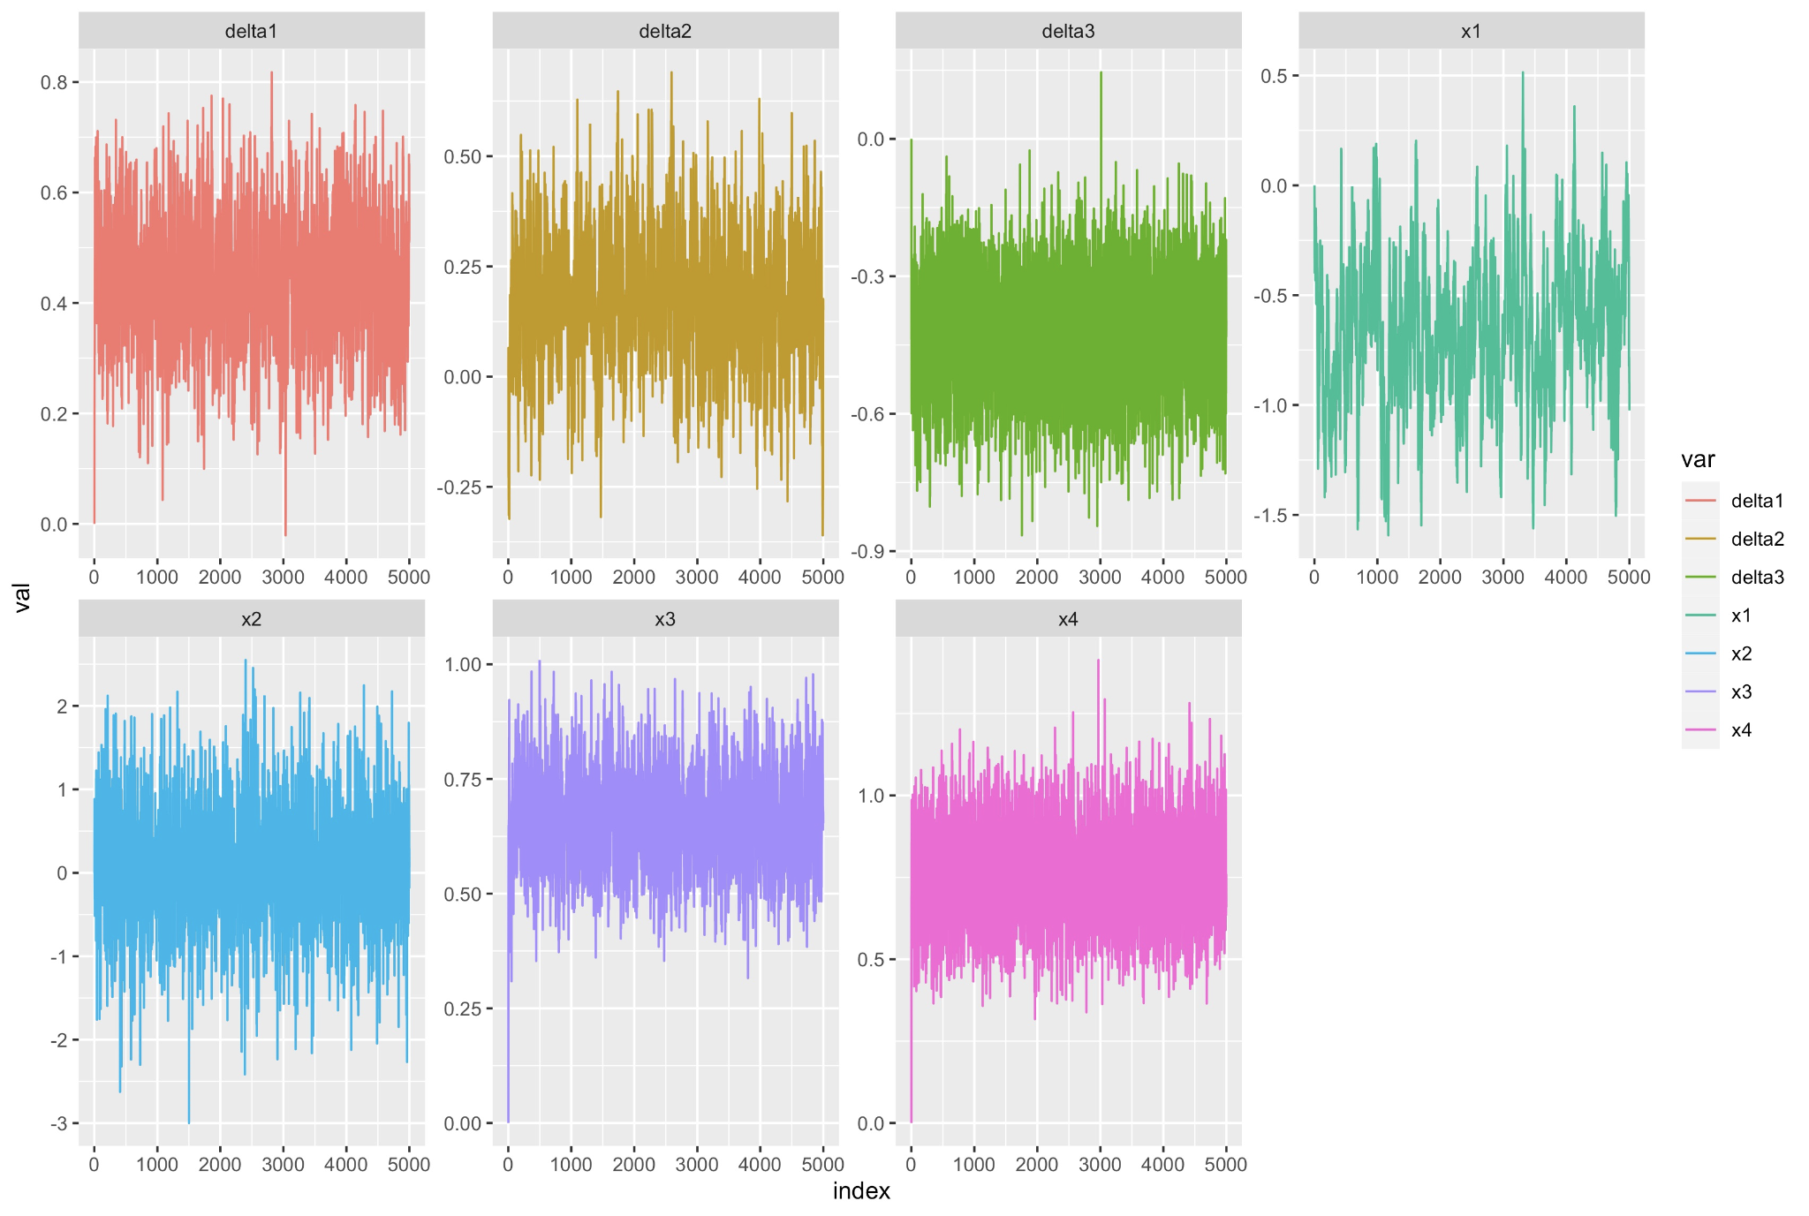
Gibbs Sampling Results (w/o Intercept)
All betas converged except for the intercept

Slide 18
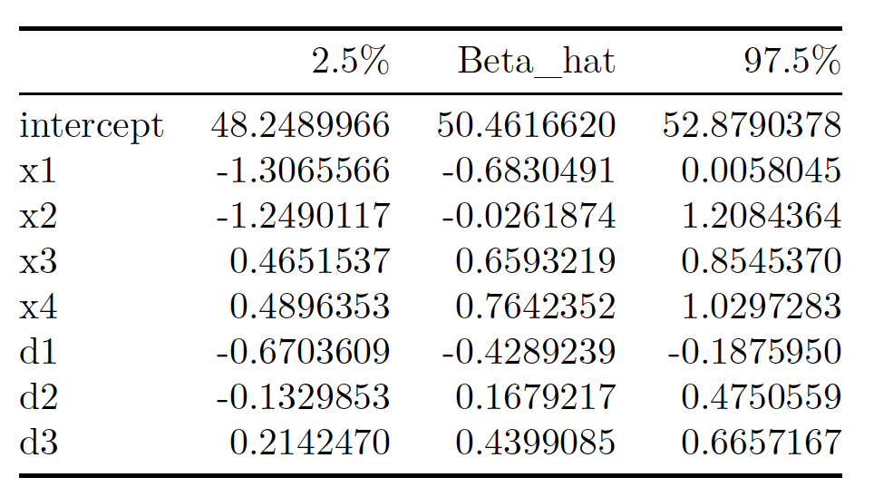
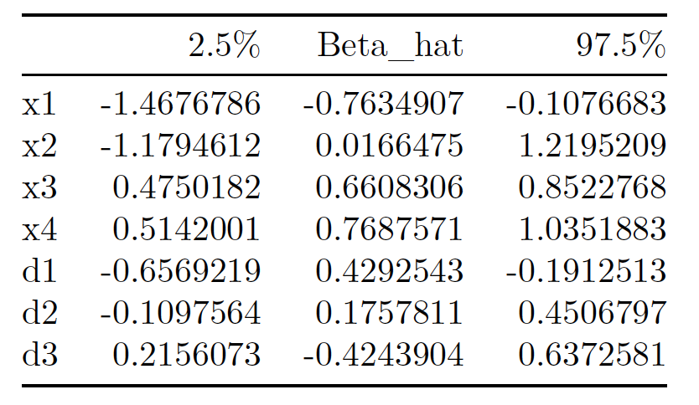
95% CI: Gibbs Sampling Results
With intercept
Without intercept

Slide 19
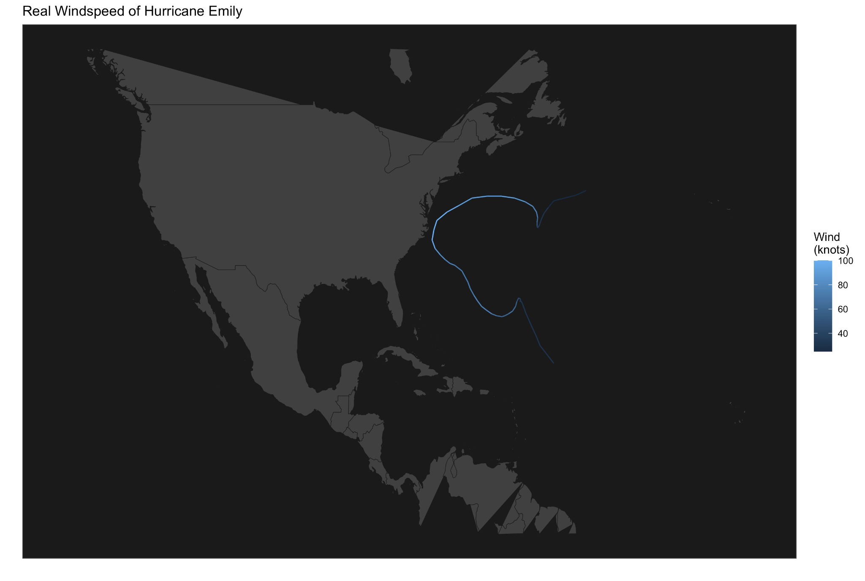

Tracking Individual Hurricanes
Real wind speeds observed
Predicted wind speeds from model with out intercept

Slide 20
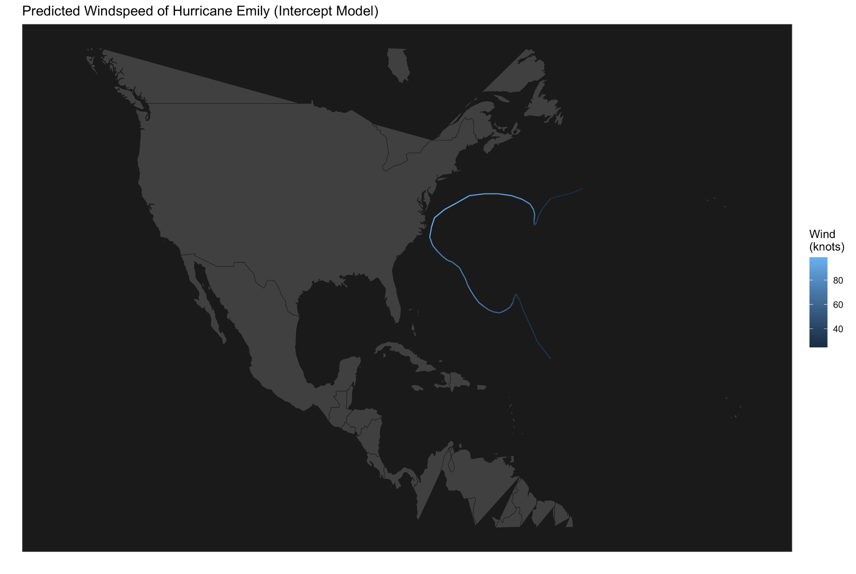
Predictions of Models: Intercept Model vs. No Intercept Model

Slide 21
Discussion/Conclusion
By plotting the predicted wind speed values on the same trajectories as the real data, we can see that for both the non-intercept and intercept model, both were able to achieve very close results to the real observed values
Might need to construct the full model with more iterations.
More combinations of initial values should be tested to achieve optimal performance. Further research should be done on why the intercept is not converging.
To improve the model, we suggest trying MH algorithm in the future to update the parameters. One should also consider calculating the accept rate periodically during the iterations process to make sure the modeling 22 process is on the right track. In addition, in this study, we excluded records with times that’s not in 00:00:00, 06:00:00, 12:00:00, 18:00:00. Further work should be done on this matter to minimize the data wasting and to study how to better accommodate different time intervals.

